Slide 1

Exploratory Data Analysis
G2M Insight for Cab Investment Firm
20-October-2022

Slide 2

Agenda
Executive Summary
Problem Statement
Approach
EDA
EDA Summary
Recommendations

Slide 3
Problem Statement
The Client
XYZ is a private firm in the US. Due to remarkable growth in the Cab Industry in the last few years and multiple key players in the market, it is planning for an investment in the Cab industry and as per its Go-to-Market(G2M) strategy, they want to understand the market before taking the final decision.
Project delivery:
You have been provided with multiple data sets that contain information on 2 cab companies. Each file (data set) provided represents different aspects of the customer profile. XYZ is interested in using your actionable insights to help them identify the right company to make their investment.
The outcome of your delivery will be a presentation to XYZ’s Executive team. This presentation will be judged based on the visuals provided, the quality of your analysis, and the value of your recommendations and insights.

Slide 4
Information of the Dataset
Cab_Data.csv: This is the main file that contains the details of 2 cab companies.
Customer_ID.csv: This is a mapping table that contains a unique identifier that links the customer’s demographic details.
Transaction_ID.csv: This is also a mapping table that contains the transactions to customer mapping and payment mode.
City.csv: As the name suggests this file contains the list of US cities, their population, and the number of cab users.

Slide 5
Approach
The approach for this dataset was simple and is as follows:
The first step was to understand each dataset and check what are the datatypes of each variable.
Then, if required transform the datatypes as to how you would like to proceed with the EDA.
Once, that was completed, the next step was to check if there are any missing values in the dataset and also check if there are any outliers.
Once, the basic pre-processing was completed, we can proceed to perform EDA to gain insights which I will be explaining in the next few slides.

Slide 6
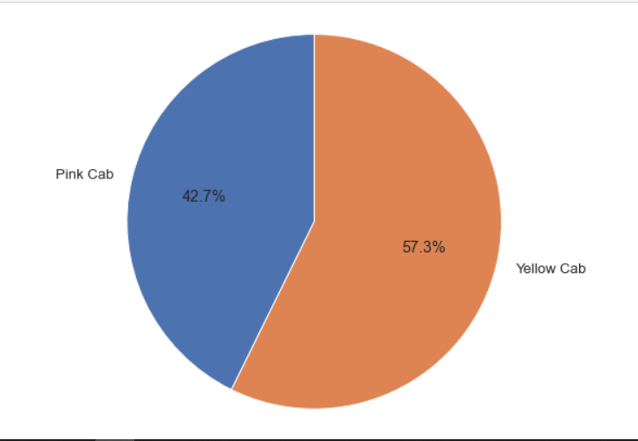
EDA Which company do the users use mostly to travel?

Slide 7
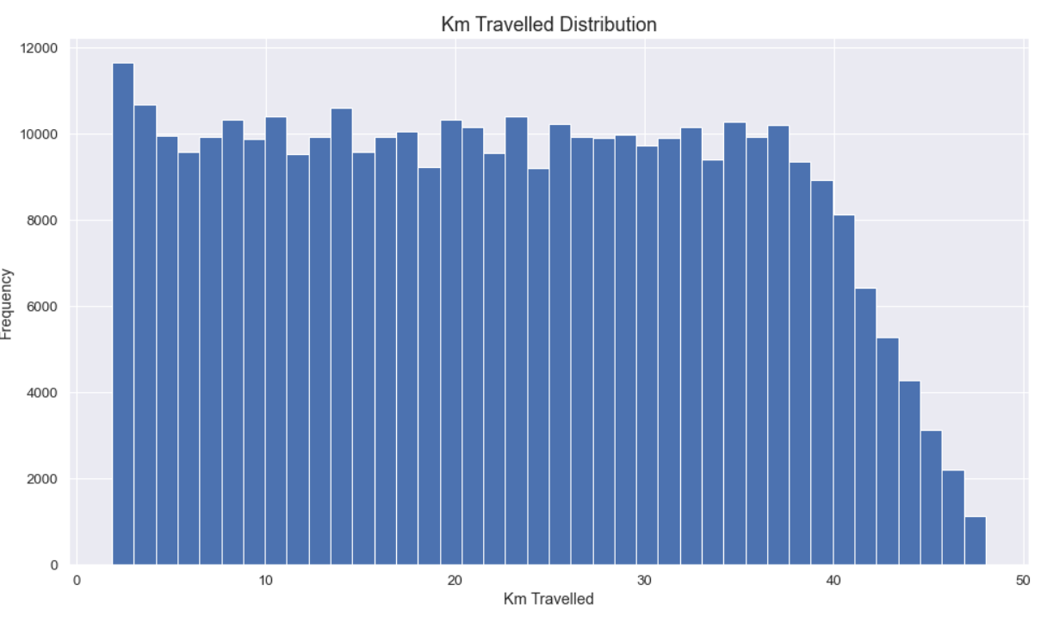
EDA What is the traveling distribution in KM?

Slide 8
EDA What is the traveling distribution in KM?

Slide 9
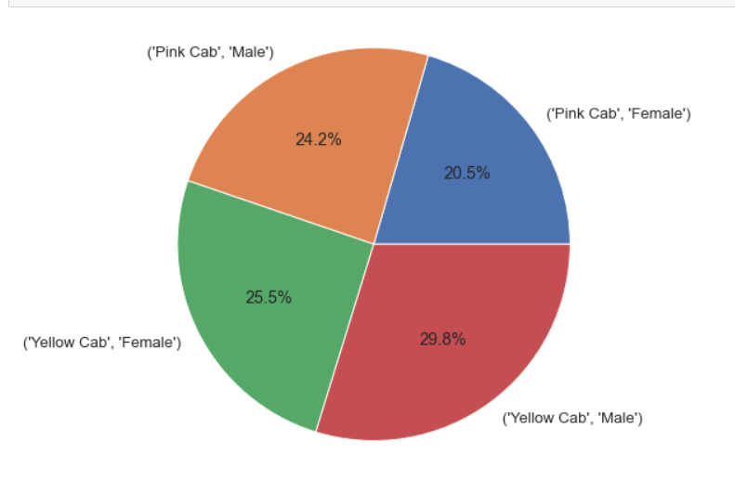
EDA Which gender prefers which cab company?

Slide 10
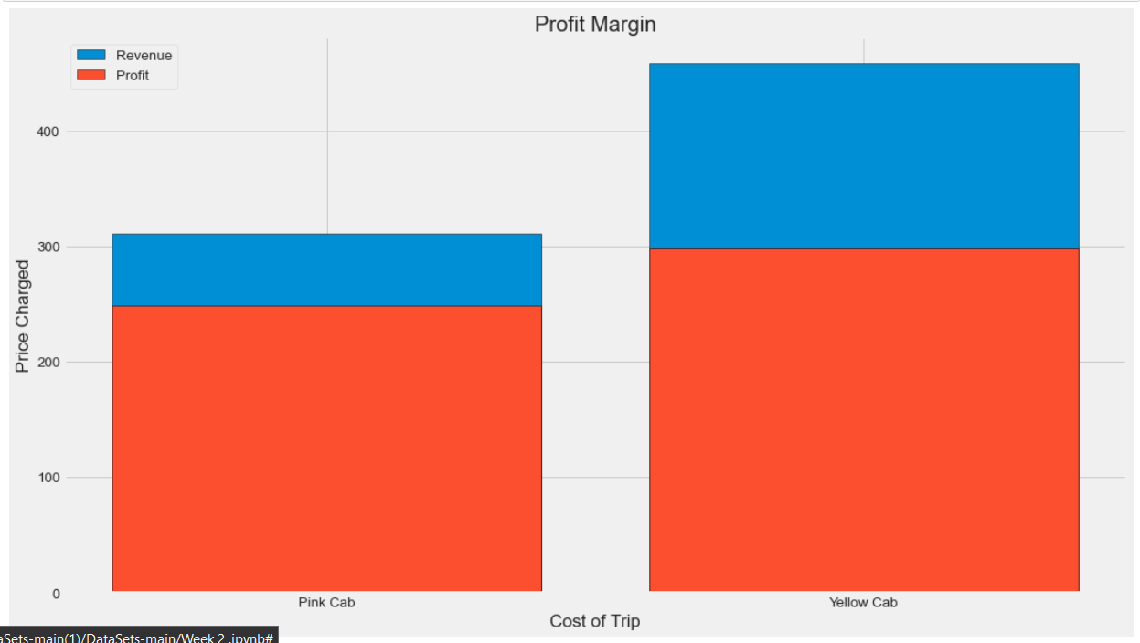
EDA What is the margin of profit?

Slide 11
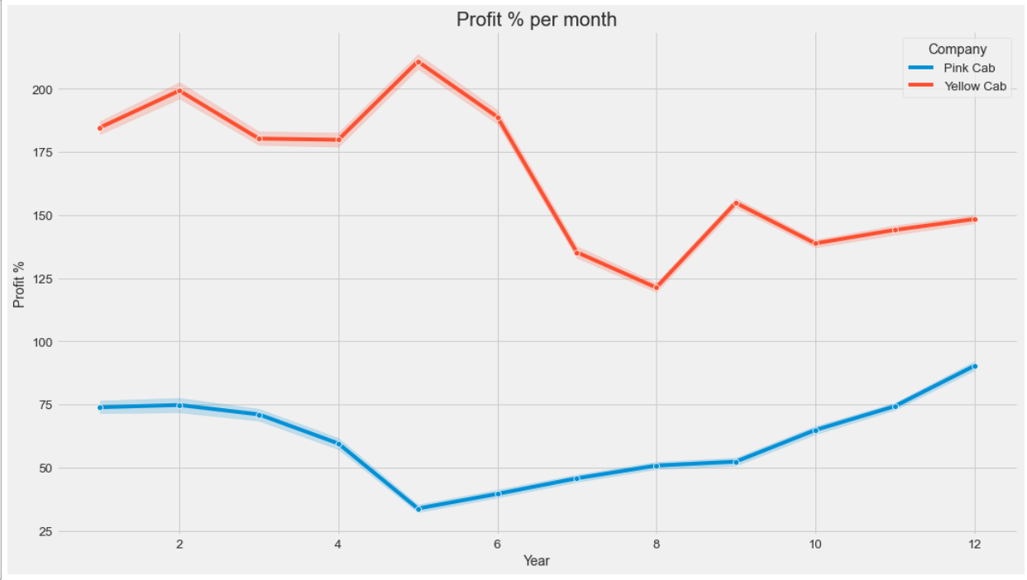
EDA What could be the margin of profit per month?

Slide 12
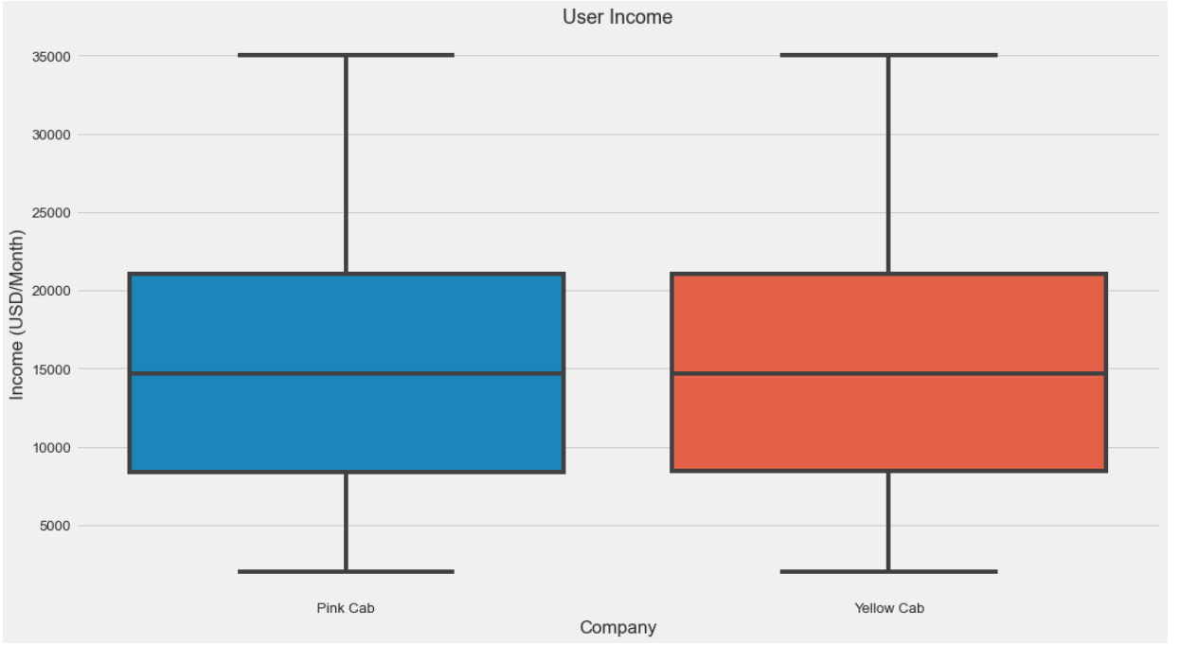
EDA What is the average income of the users?

Slide 13
Hypothesis Testing Hypothesis 1: Is there any difference in profit regarding Gender?
Conclusion: There is no difference regarding Gender in the cab companies.

Slide 14
Hypothesis Testing Hypothesis 2: Could there be a difference in the profit regarding age?
Conclusion: It looks like the yellow cab company offers some kind of discount for users who are more than 50 years old.

Slide 15
Hypothesis Testing Hypothesis 2: Is there any difference in the profit regarding the payment mode?
Conclusion: There is no difference in the payment mode of both the cab companies.

Slide 16
EDA Summary
As far as I am concerned, the yellow cab company is better than the Pink Cab company because:
The profit margin is higher
There are more users who travel by yellow cab which will increase their profit.
Since there are more users travelling by yellow cab, hence there might be more transactions per year as well.

Slide 17
The END
Thank You

